Slide 1
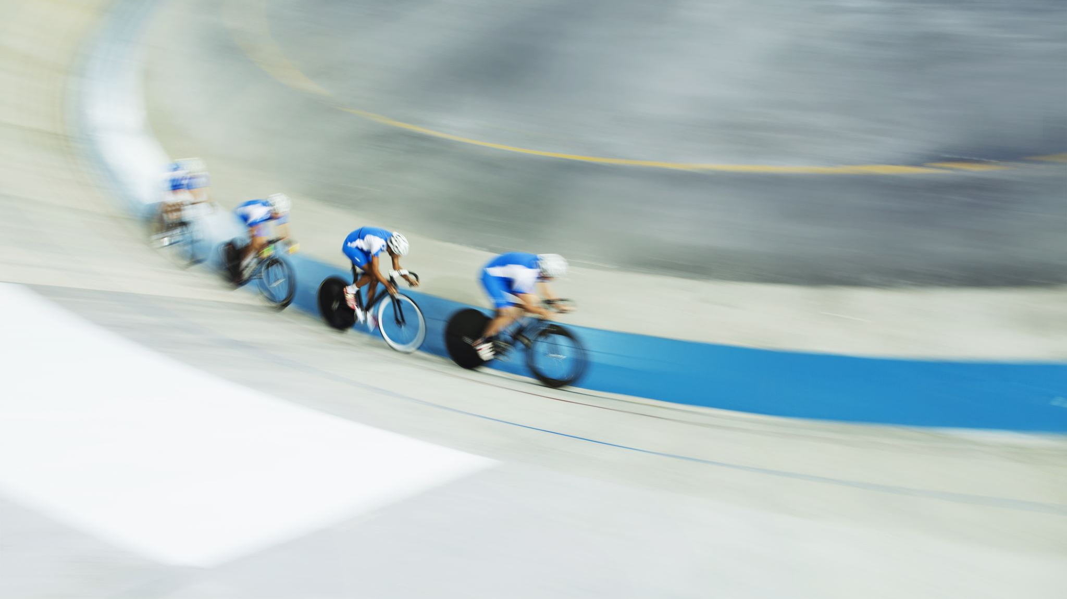
Designing marketing strategies aimed at converting casual riders into annual members

Slide 2
How do annual members and casual riders use bikes differently?
Based on the analysis of ride data from Divvy (Cyclistic), there are clear differences in how annual members and casual riders use the bike-sharing service:
Ride Duration
Day of Week Usage
Time of Day Patterns
Station Usage

Slide 3
Ride Duration / Day of Week Usage
Casual riders generally take longer rides than members.
This suggests casual users are more likely to use the bikes for leisure or recreational purposes.
Members show relatively consistent usage across weekdays, especially during workdays — indicating commuting patterns.
Casual riders use the bikes more on weekends, pointing to non-commute, recreational trips.

Slide 4
Time of Day Patterns / Station Usage
Members tend to ride during morning and evening peak hours, aligning with typical work commute times.
Casual riders are more active during midday and afternoons, when people are more likely to ride for fun or during free time.
Casual riders often start trips near tourist attractions or parks.
Members tend to start near business or residential areas, consistent with daily commuting.

Slide 5
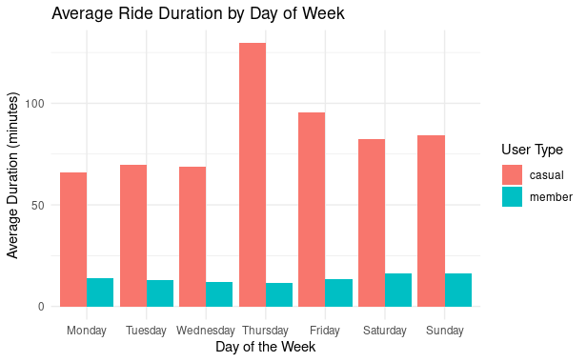
In Conclusion
Annual members typically use Cyclistic bikes for transportation and routine trips, while casual riders use the bikes for leisure and exploration. These patterns highlight opportunities for targeted marketing and service improvements tailored to each user group.

